Slide 1
Predicting early signs of autism using facial landmarks with series of video frames

Slide 2
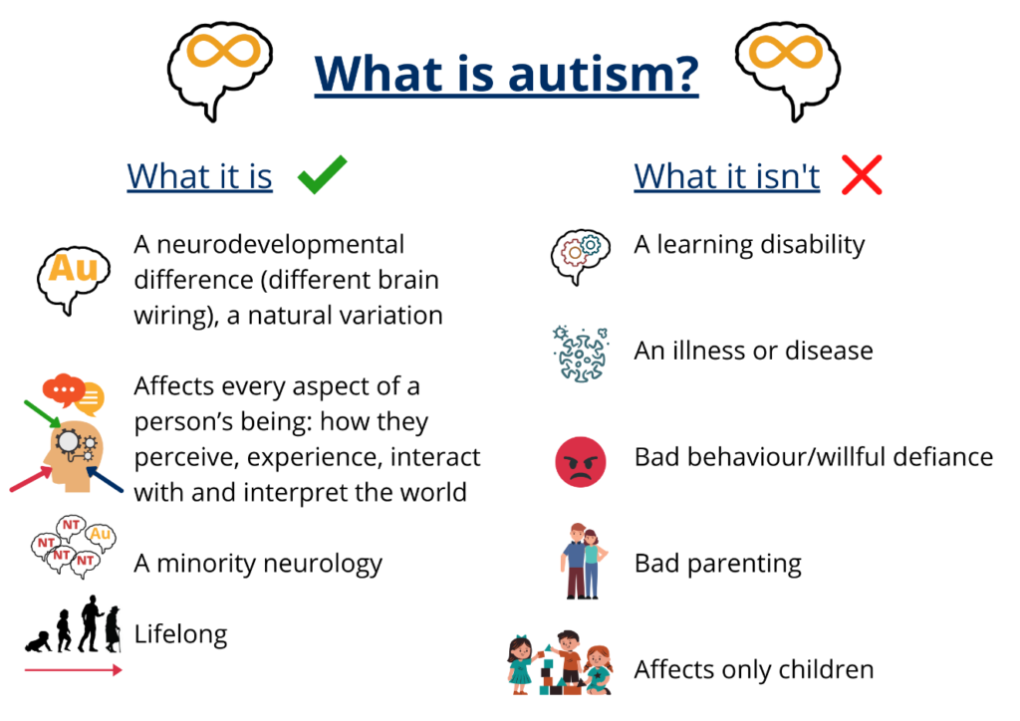

Slide 3
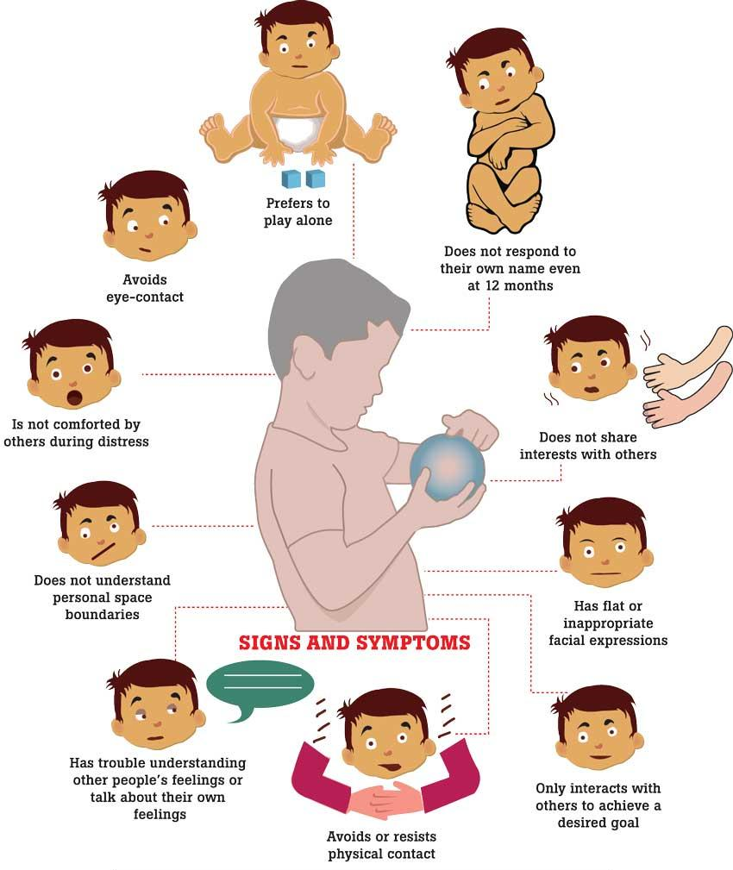
physical signs of autism in babies

Slide 4
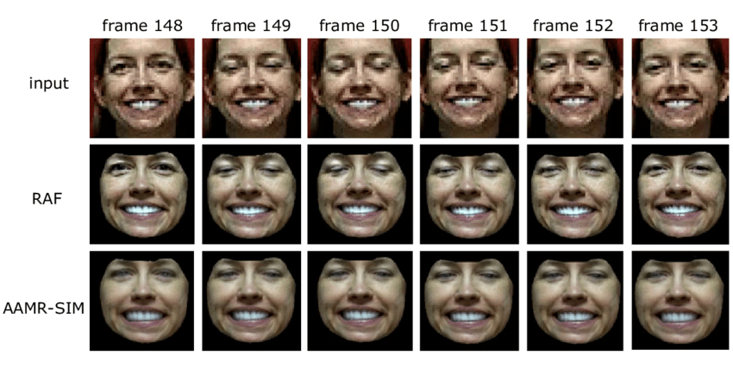
The Data!

Slide 5
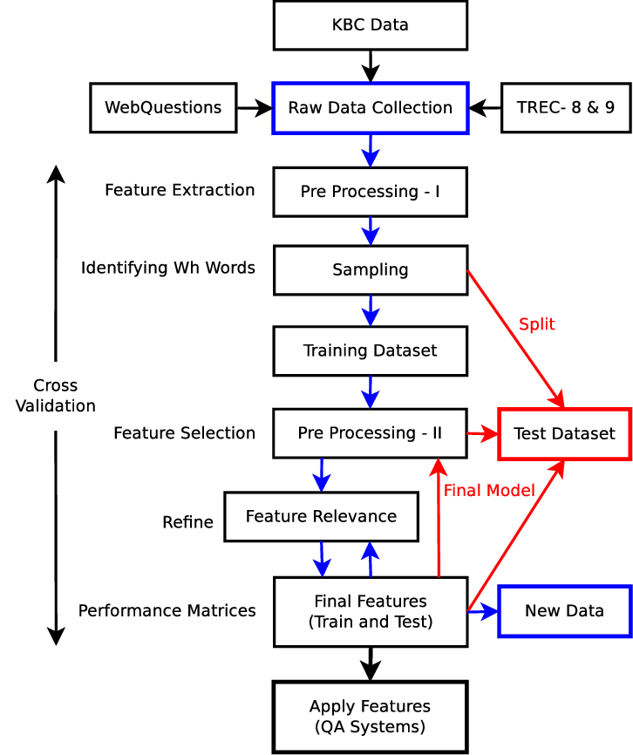
Dataset and feature extraction!
Dataset is a collection of data pieces that can be treated by a computer as a single unit for analytic and prediction purposes. This means that the data collected should be made uniform and understandable for a machine that doesn't see data the same way as humans do.
Feature Extraction aims to reduce the number of features in a dataset by creating new features from the existing ones (and then discarding the original features).

Slide 6
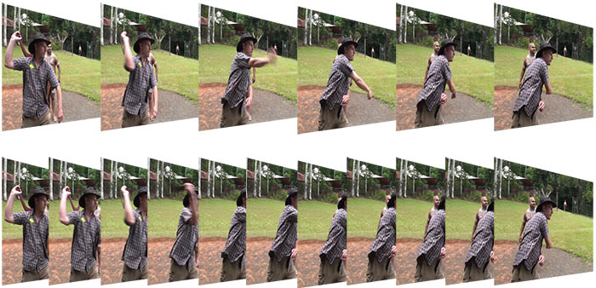
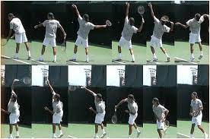
Video => Frames

Slide 7
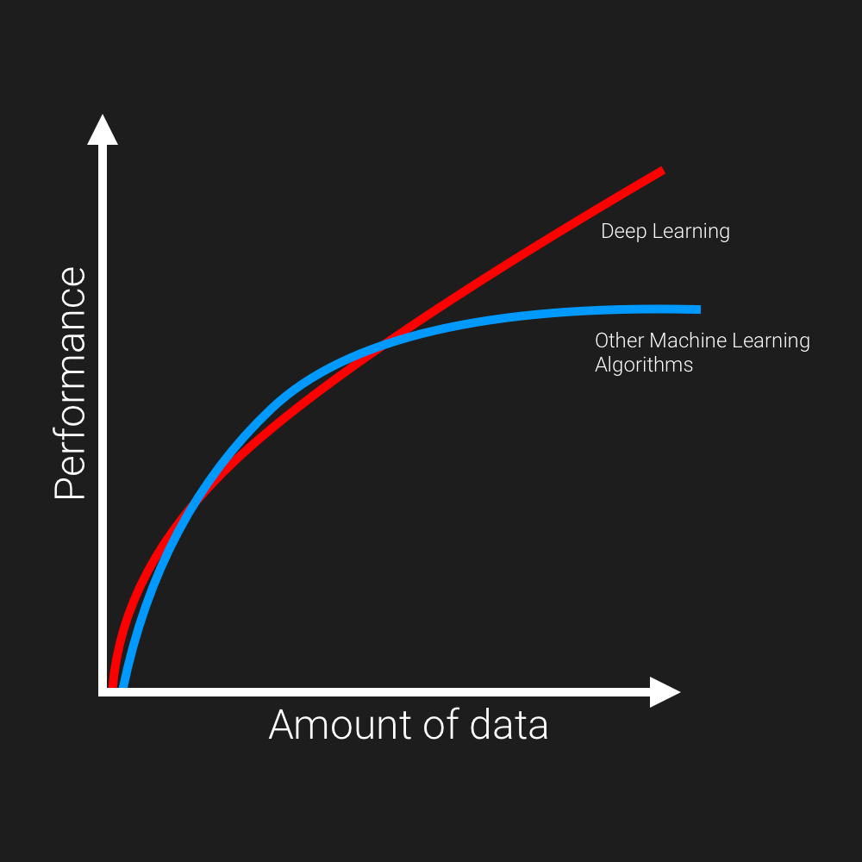
Deep learning vs. machine learning
If the amount of data increase =

Slide 8
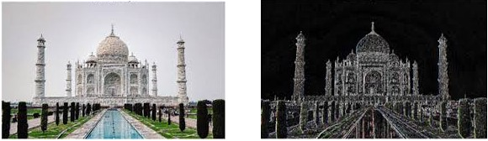
Convolution Neural Network (CNN)
The building blocks of CNNs are filters a.k.a. kernels.
Kernels are used to extract the relevant features from the input using the convolution operation.
Though convolutional neural networks were introduced to solve problems related to image data, they perform impressively on sequential inputs as well.

Slide 9
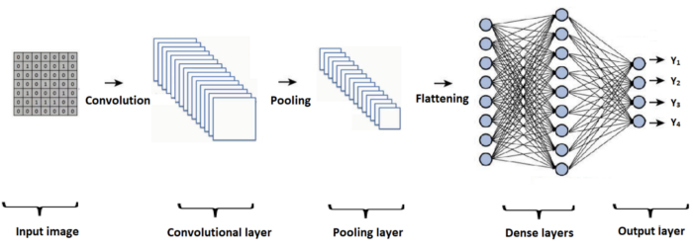
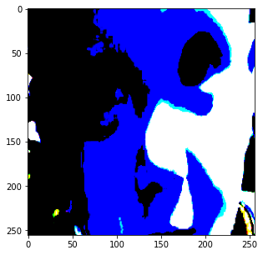
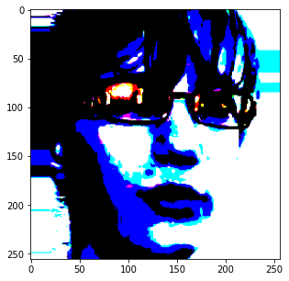
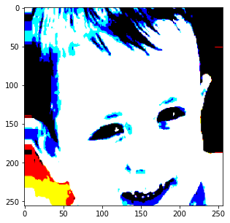
Understanding the VGG19

Slide 10
Questions?!
&
Thank You!

